Slide 1


RELATIONAL MODEL TOUROPERATOR
AUTORS:
FERNANDO MUÑOZ RAMIREZ
RUBÉN NAVARR TRUJILLO
INMACULADA VALERO FRIAS

Slide 2
ER MODEL

Slide 3
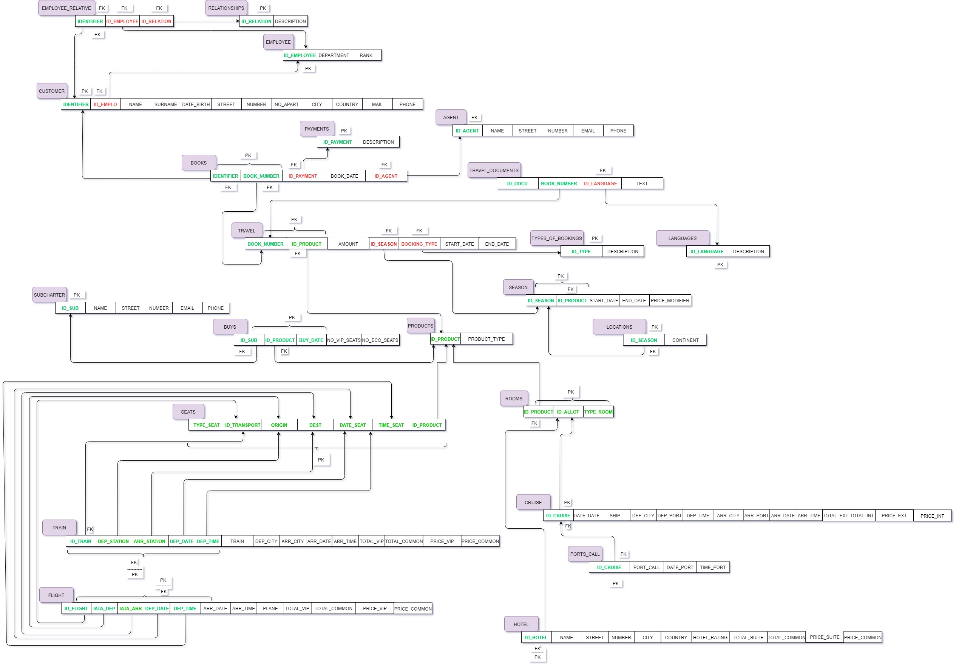
2. RELATIONAL MODEL
PRIMARY KEY
FOREIGN KEY

Slide 4
3. DESIGN DEVELOPMENT
Employee_Relative
PK -> Identifier
FK -> Identifier, ID_Employee, ID_Relation
Travel
PK -> Book_number, ID_Prodcut
FK -> ID_Product, ID_Season, Booking_type
Relationships
PK -> ID_Relation
Travel_Documents
PK -> Book_number, ID_Docu
FK -> ID_Language
Employee
PK -> ID_Employee
Languages
PK -> ID_Languages
Customer
PK -> Identifier
FK -> ID_Emplo
Type_Of_Booking
PK -> ID_Type
Agents
PK -> ID_Agent
Product
PK -> ID_Prodcut
Books
PK -> Identifier, Book_number
FK -> Identifier, Book_number, ID_Payment, ID_Agent
Season
PK -> ID_Prodcut, ID_Season
FK -> ID_Product
Payments
PK -> ID_Payment
Locations
PK -> ID_Season
FK -> ID_Season

Slide 5
Buys
PK -> ID_Prodcut, ID_Sub, Buy_Date
FK -> ID_Prodcut, ID_Sub
Subcharter
PK -> ID_Sub
Seats
PK -> Type_Seat, ID_Transport, Origin_Dest, Date_Seat, Time_Seat, ID_Product
Train
PK -> ID_Train, Dep_Station, Arr_Station, Dep_Date, Dep_Time
FK -> ID_Train, Dep_Station, Arr_Station, Dep_Date, Dep_Time
Rooms
PK -> ID_Product, ID_Allot, Type_Room
FK -> ID_Product
Flight
PK -> ID_Flight, Iata_Dep, Iata_Arr, Dep_Date, Dep_Time
FK -> ID_Flight, Iata_Dep, Iata_Arr, Dep_Date, Dep_Time
Cruise
PK -> ID_Cruise
FK -> ID_Cruise
Port_Calls
PK -> ID_Cruise
FK -> ID_Cruise
Flight
PK -> ID_Flight, Iata_Dep, Iata_Arr, Dep_Date, Dep_Time
FK -> ID_Flight, Iata_Dep, Iata_Arr, Dep_Date, Dep_Time
Hotel
PK -> ID_Hotel
FK -> ID_Hotel

